Slide 1

Auto Insurance Data Analysis
ROHAN VENKATESH

Slide 2

BUSINESS UNDERSTANDING
The business challenge was to analyze customer behavior and claim patterns in an auto insurance portfolio. The goal was to help the organization:
Identify high-risk customers
Understand customer value and profitability
Explain how education, employment, and marital status affect claim likelihood and premiums
Segment customers for personalized marketing and risk management

Slide 3
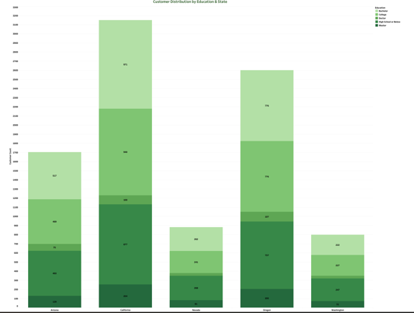
EXPLORING CUSTOMER DEMOGRAPHICS
SQL was used to examine customer characteristics across key dimensions.
The focus was heavily on factors like education, employment, marital status, and geographic distribution.
Clear regional patterns were detected in customer profiles.
States varied significantly in education level, which in turn influenced the employment type and premium behavior.

Slide 4
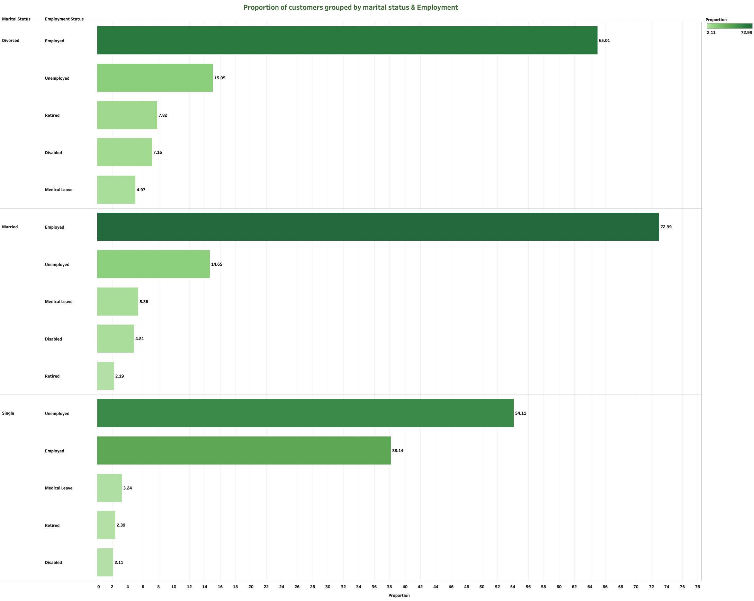
Segmenting Customers by Life Stage
By analyzing employment status within marital categories, we identified trends that could help design life-stage-based insurance products.
Married employed customers dominate the portfolio, but we also identified underserved groups like single unemployed individuals and widowed retirees.

Slide 5
Data preparation
Python was used to:
Convert premium and customer lifetime value (CLV) columns from text to numeric
Handle missing or invalid entries
Prepare clean, structured CSV files for Tableau
Calculate a custom risk score using a simple rules-based model combining complaints, claims, and premium size

Slide 6
PREMIUM VS CLV INSIGHTS
We compared average premium paid and customer lifetime value across education levels.
While premiums remain relatively stable, CLV varies widely — customers with advanced education tend to stay longer and offer higher lifetime profitability.

Slide 7
CLAIMS BY STATE
We analyzed claim distribution across states to spot high-claim regions.
Some states showed unusually high claim activity relative to their customer base. This helps target fraud checks and adjust risk pricing accordingly.

Slide 8
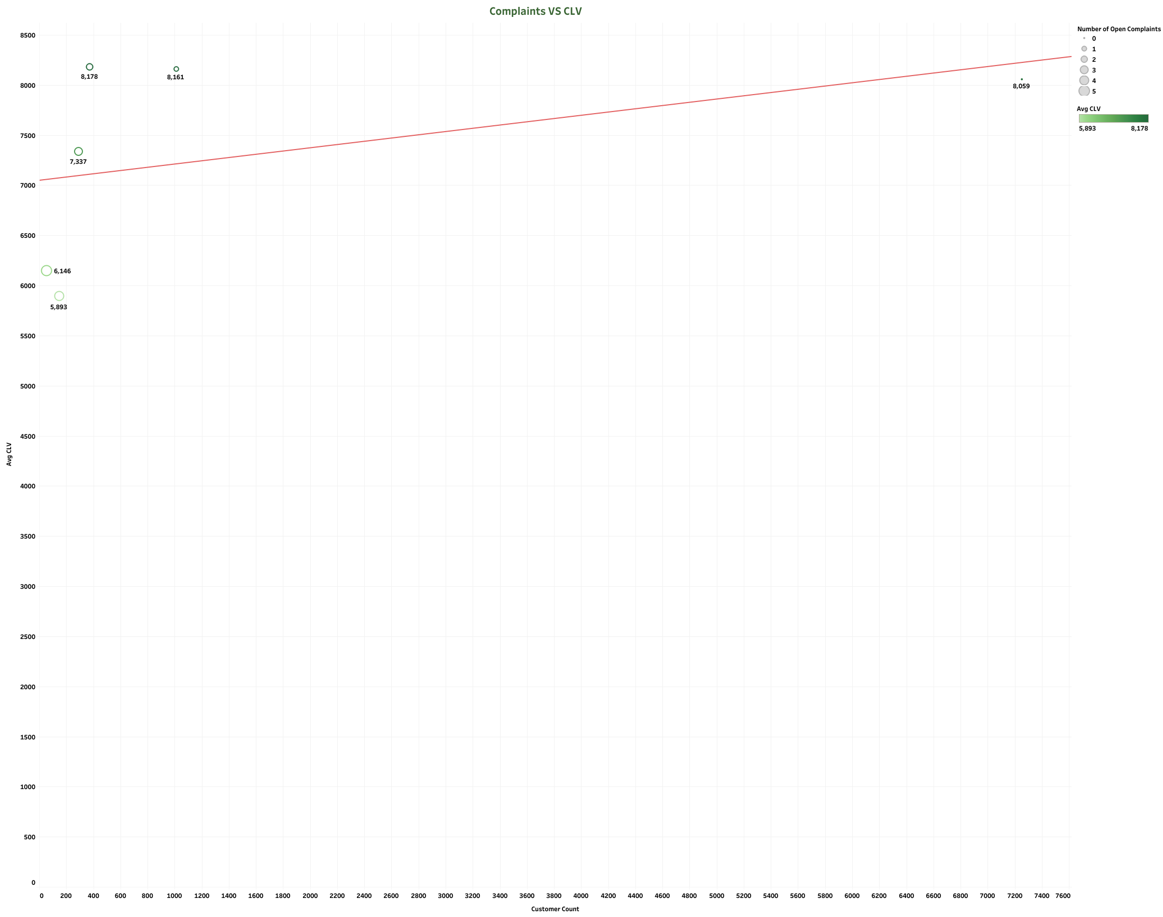
COMPLAINTS VS CLV
Customers with multiple complaints consistently show lower lifetime value.
This relationship emphasizes the importance of resolving complaints proactively to protect long-term revenue.

Slide 9
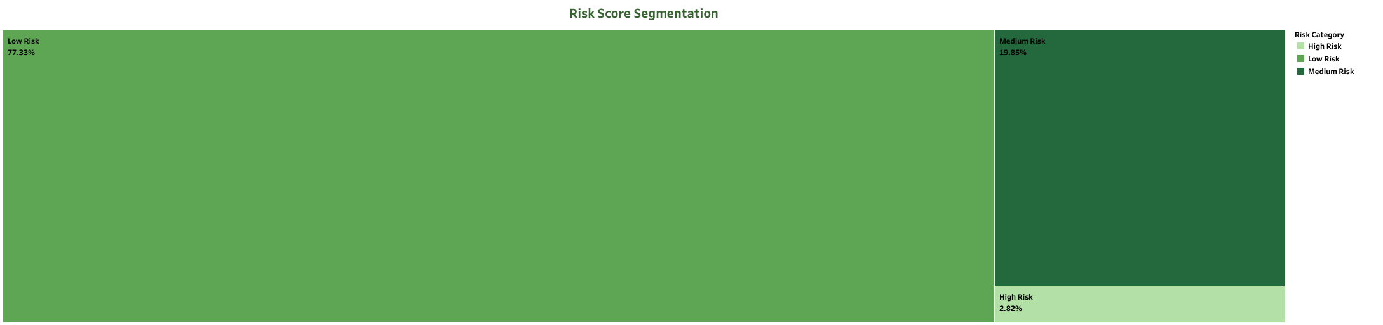
RISK SEGMENTATION
We created a simple scoring model based on premium size, complaints, and claims.
Customers were segmented into three groups: Low, Medium, and High Risk.
This segmentation enables the company to prioritize monitoring and apply personalized retention or pricing strategies.

Slide 10
PREDICTING CLAIM RISK
We built and tested three models: Logistic Regression, Random Forest, and Gradient Boosting.
The Random Forest model performed the best with 100% test accuracy, showing strong separation between claim and non-claim customers.

Slide 11
MODEL EVALUATION
Although Random Forest performed very well on the test set, it may be slightly overfitted.
Further validation is needed using unseen datasets.
Key Insight: The model was excellent at identifying claim-prone customers with very few false positives. This supports its use for proactive risk targeting.

Slide 12
DASHBOARD SUMMARY
All insights were compiled into a single, interactive Tableau dashboard. Stakeholders can filter by state, education, employment, and risk level to:
Understand customer demographics
Spot regional and segment risk
Monitor claim trends and customer value
Enable proactive outreach and risk pricing

Slide 13
BUSINESS IMPACT
Better Risk Management: Identify high-risk customers for proactive retention or tighter underwriting.
Improved Customer Segmentation: Tailor products and pricing based on employment, education, and complaints.
Data-Driven Decisions: Equip marketing and risk teams with interactive dashboards for smarter daily operations.

Slide 14
NEXT STEPS – FROM PILOT TO PRODUCTION
Deploy Tableau dashboard to business teams
Integrate risk scores into underwriting and retention workflows
Test model on live production data
Expand framework to property and commercial insurance products
Monitor performance over time with monthly refresh

